Slide 1

Billie Askew Oral Reading Assessment
Notes:
Teacher Leaders: Use the notes under the slides as support as you share the testing packet with teachers at your site.

Slide 2
Timeline
September 2020
December 2021
October 2022
September 2023
January 2022
May 2023
Spring - Fall 2021
Notes:
September 2020 NATG approved a motion to replace the testing packet. The changes to the testing packet were prompted by ta lack of diversity and stereotypes depicted in the original texts.
Spring-Fall 2021 Book collections were identified, permissions granted, books were screened regarding diversity, cultural relevance, content relevant to a first grader.
December 2021 TLs and Trainers qualitatively reviewed books and levels. Methodology was finalized.
January 2022 Books were reviewed by Trainers, final book set identified, book introductions written
October 2022 Field Testing occurred
May 2023 Quantitative analysis of research data
September 2023 NATG Adopted Billie Askew Oral Reading Assessment

Slide 3
Selection of Books
Goal: Test multiple books per level to identify one text for each level
Possible books were reviewed and analyzed for diversity
After the review:
Four books per level up to Level 18 (except for Level 6)
Levels 20-30, three books per level (except for 24)
Notes:
Books needed to be those where publication rights could be secured.
Level 6 – 3 books tested
Level 24 – 6 books tested
There are some books that are older publications because these are the books for which RRCNA could secure publishing rights.

Slide 4
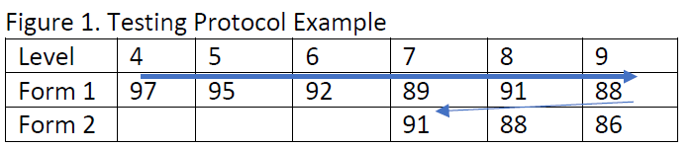
Testing Procedures
Books were randomly assigned and paired
Eight testers (2 Tr, 6 TL), 13 schools (CA, OH, SC, TX, WV), 129 students
Students were randomly selected from multiple reading levels
For each book: Running Record and NAEP Oral Reading Fluency Rubric
Notes:
Yes, some books are now a different level. Original books were only tested in OH with a smaller sample of students.
This time there were more students, across the United States, in different sized districts allowing for a more diverse group of students.

Slide 5
Procedures for Administration

Slide 6
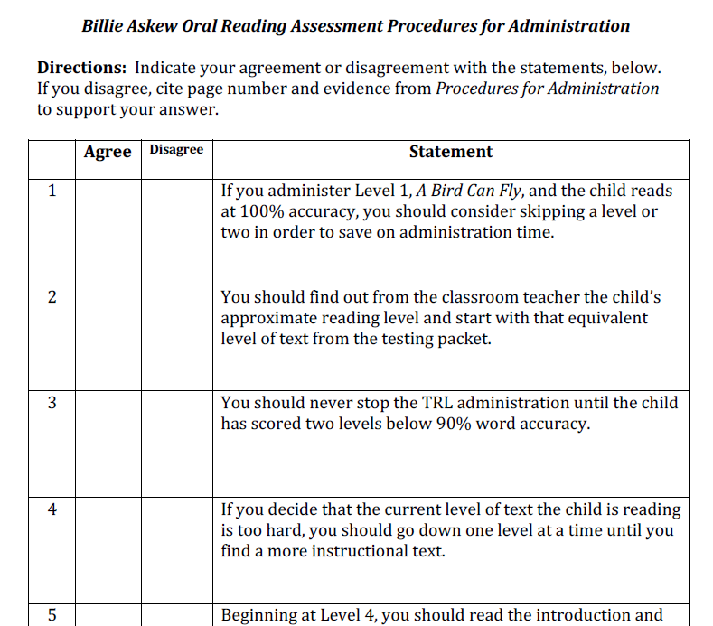

Respond to each statement with a friend (or two) at your table and cite page numbers.
Notes:
Give teachers about 10 minutes to work with a partner on the handout.
Then do the following slides individually and invite conversation.
You’ll notice each slide has multiple clicks for more interaction.

Slide 7

If you administer Level 1, A Bird Can Fly, and the child reads at 100% accuracy, you should consider skipping a level or two in order to save on administration time.
Level 1 A Bird Can Fly and Level 2 House Cleaning are always administered together. p. 2
Notes:
Read the top statement.
Invite teachers to share “agree” or “disagree.”
Click to show “agree” or “disagree.”
Ask teachers to share where they found the answer.
Once they have shared, click to show citation on slide.
Repeat for slides 7-15.

Slide 8
You should find out from the classroom teacher the child’s approximate reading level and start with that equivalent text from the testing packet.
Find out from the classroom teacher (K and/or 1st) the approximate level the child is reading for classroom instruction.
Begin the text reading observation at the next lower level. p. 2

Slide 9
You should never stop the TRL administration until the child has scored two levels below 90% word accuracy.
NOTE: Reading can be stopped after one level below 90% if the child is showing signs of frustration of the score is significantly below 90% with a loss of meaning and little or no self-correction. If the accuracy score is below but close to 90% with evidence of successful processing, continue testing until two levels are below 90%. p. 3
Notes:
Additional reference: p. 4 - 1st bullet “one or two consecutive levels”

Slide 10
If you decide the current level of text the child is reading is too hard, you should go down one level at a time until you find a more instructional text.
If the record is well below 90%, go down several levels if possible. p. 3

Slide 11

Beginning at Level 4, you should read the introduction and invite the child to look at the pictures before the child starts to read.
At text levels 4 to 16 the teacher invites the child to look at the pictures before asking the child to read. Students are prompted to survey the pictures for the portion to be read at levels 18 to 24. p. 2
Notes:
The title and introduction may be restated after the child has looked at the pictures.

Slide 12
If the child reads A Bird Can Fly and House Cleaning below 90% accuracy, the text reading administration can stop.
If the Record is below 90% at Level 1 A Bird Can Fly and/or Level 2 House Cleaning follow the directions for Observing Early Responses to Text. p. 3

Slide 13
This is the first major revision of text reading passages since 1984 when Reading Recovery was introduced in the United States.
The long-term development of the leveled text passages and the standard book introductions for each passage were completed in 1990. p. 10
Notes:
1984-1985 First text passages used
1986 independent passages compiled
Subsequent years extensive field testing and analyses to establish reliability
1980 Where’s Spot added

Slide 14
For levels 1-24, the error count (E) on the front of each book represents the number of errors made that indicates the child is below 90%.
E = errors: The number of errors made that result in a hard score. p. 11

Slide 15
It is optional to find three levels of text difficulty for children selected for Reading Recovery.
It is critical to find three levels of text difficulty for all children selected for entry to Reading Recovery. The three levels should be determined before completing An Observation Survey Summary Sheet. p. 6
Notes:
If three levels of text difficulty cannot be established additional samples of text reading should be observed in order to be able to analyze useful and problematic strategies on text.
p. 8, 2nd bullet
3 levels of text difficulty for each child

Slide 16
Frequently Asked Questions
Why is there no alternative text? What should we use if another book is needed?
Talk to the trainer/s at your UTC.
Some of the books in the testing packet are in the book set for lessons. What do I do with those?
Remove them from your book set and don’t use for lessons.
The directions on Levels 20-30 seem confusing. What should I read to introduce the book?
Read the introduction and the words in bold print.
Practice introducing the higher levels, especially Level 28, before administration.

Slide 17

Notes:
Give teachers additional time to look through administration procedures and testing books.
Allow time for additional questions.
If there are additional questions that aren’t answered in the procedure booklet, please direct them to the trainer/s at your UTC.

